Slide 1

Pizza Sales Analysis Report
Agenda
E R Diagram
Basic Findings ( 5 queries )
Intermediate Findings ( 5 queries )
Advance Findings ( 3 queries )

Slide 2

Agenda :
1.Retrieve the total number of orders placed.
2.Calculate the total revenue generated from pizza sales.
3.Identify the highest-priced pizza.
4.Identify the most common pizza size ordered.
5.List the top 5 most ordered pizza types along with their quantities.
6.Join the necessary tables to find the total quantity of each pizza category ordered.
7.Determine the distribution of orders by hour of the day.
8.Join relevant tables to find the category-wise distribution of pizzas.
9.Group the orders by date and calculate the average number of pizzas ordered per day.
10.Determine the top 3 most ordered pizza types based on revenue.
11.Calculate the percentage contribution of each pizza type to total revenue.
12.Analyze the cumulative revenue generated over time.
13.Determine the top 3 most ordered pizza types based on revenue for each pizza category.
Slide 2 of 17

Slide 3
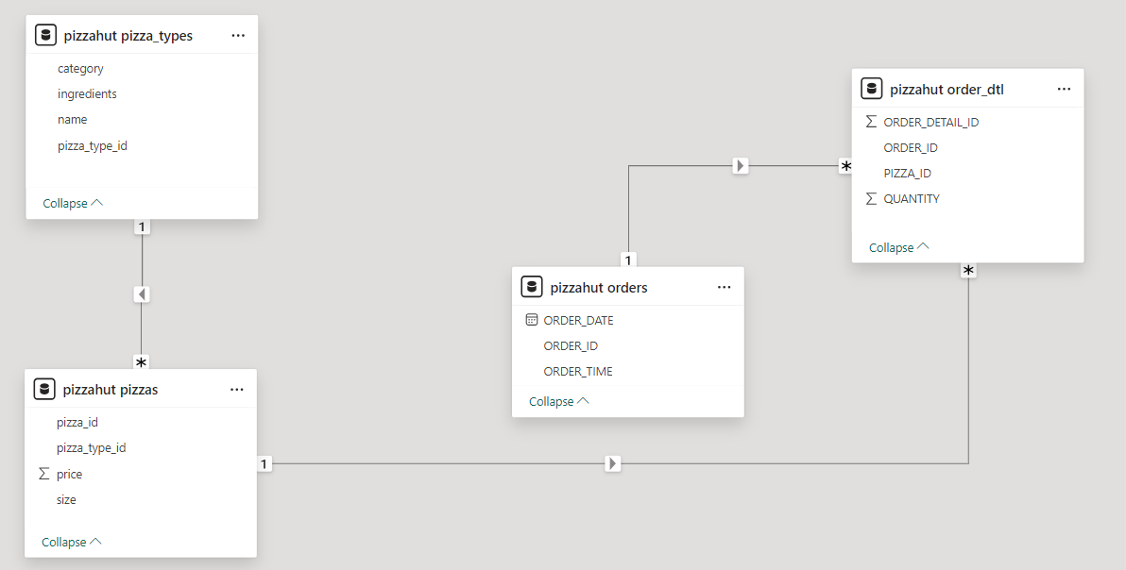
E R Diagram :
Slide 3 of 17

Slide 4

1.Retrieve the total number of orders placed.
Slide 4 of 17

Slide 5
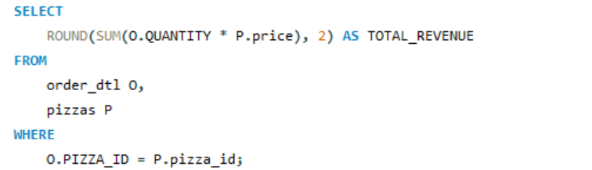
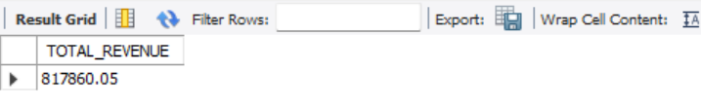
2.Calculate the total revenue generated from pizza sales.
Slide 5 of 17

Slide 6
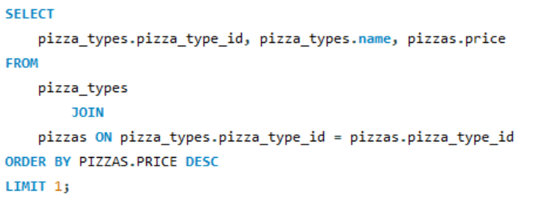

3.Identify the highest-priced pizza.
Slide 6 of 17

Slide 7
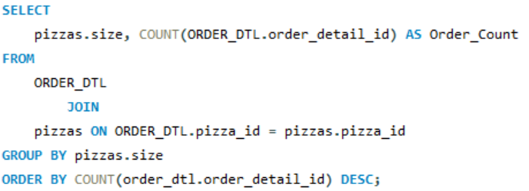
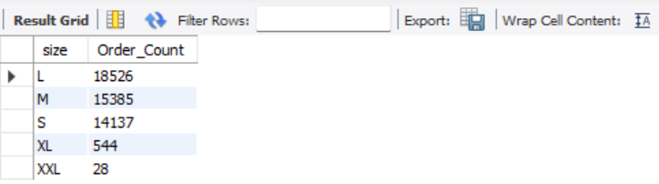
4.Identify the most common pizza size ordered.
Slide 7 of 17

Slide 8
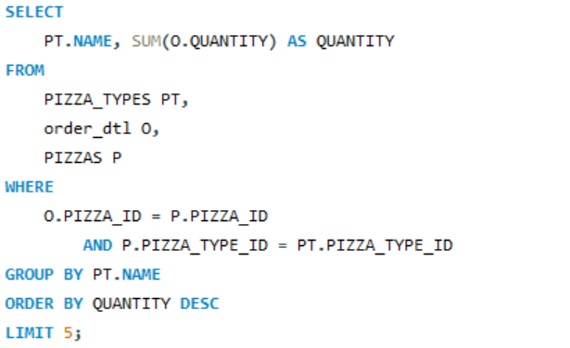
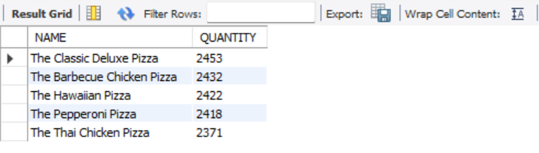
5.List the top 5 most ordered pizza types along with their quantities.
Slide 8 of 17

Slide 9
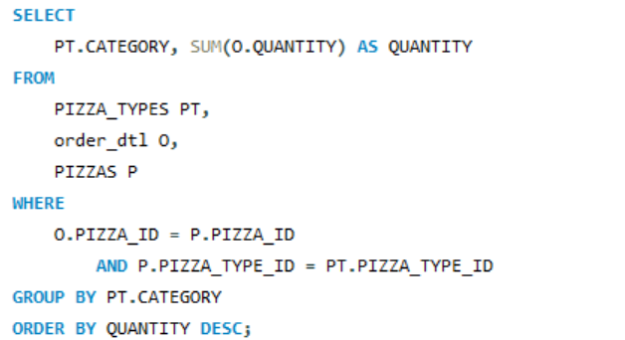
6.Join the necessary tables to find the total quantity of each pizza category ordered.
Slide 9 of 17

Slide 10
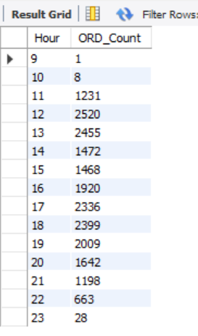
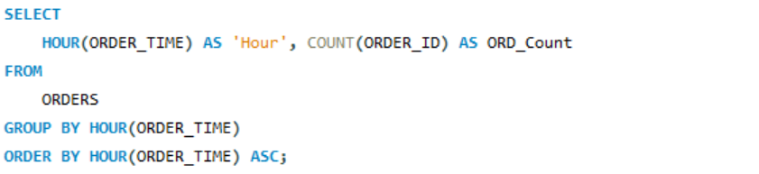
7.Determine the distribution of orders by hour of the day.
Slide 10 of 17

Slide 11
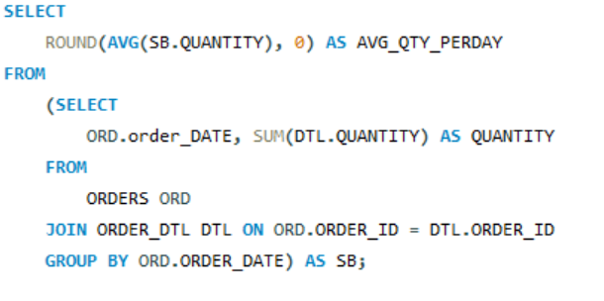
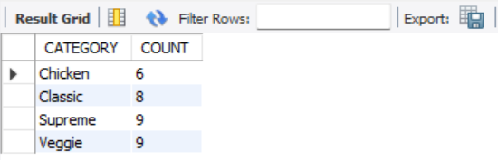
9.Group the orders by date and calculate the average number of pizzas ordered per day.
Slide 11 of 17

Slide 12
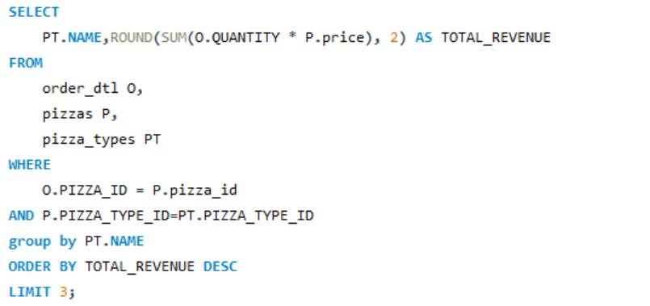
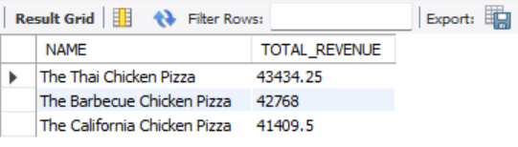
10.Determine the top 3 most ordered pizza types based on revenue.
Slide 12 of 17

Slide 13
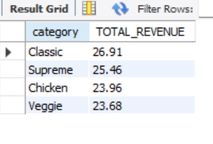
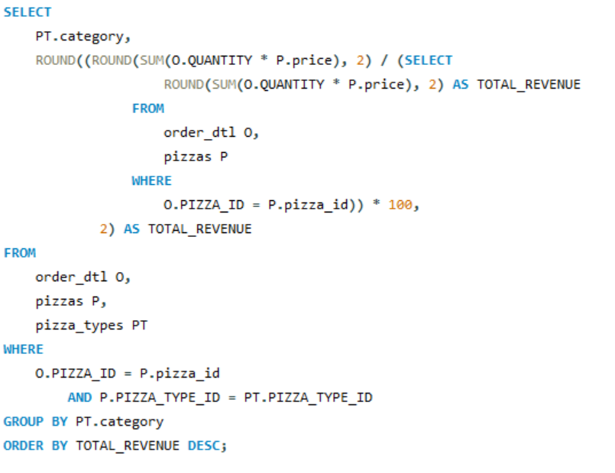
11.Calculate the percentage contribution of each pizza type to total revenue.
Slide 13 of 17

Slide 14
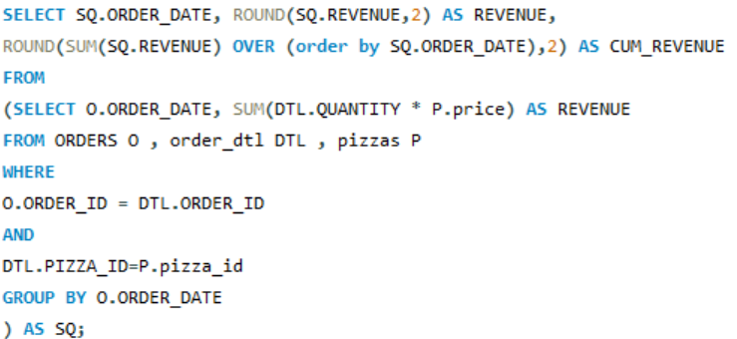
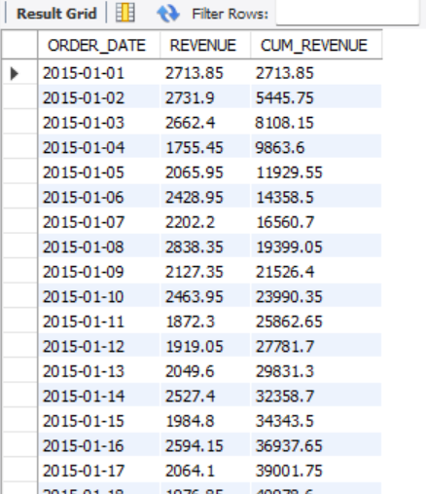
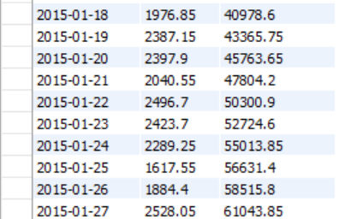
12.Analyze the cumulative revenue generated over time.
Slide 14 of 17

Slide 15
9.Group the orders by date and calculate the average number of pizzas ordered per day.
Slide 15 of 17

Slide 16
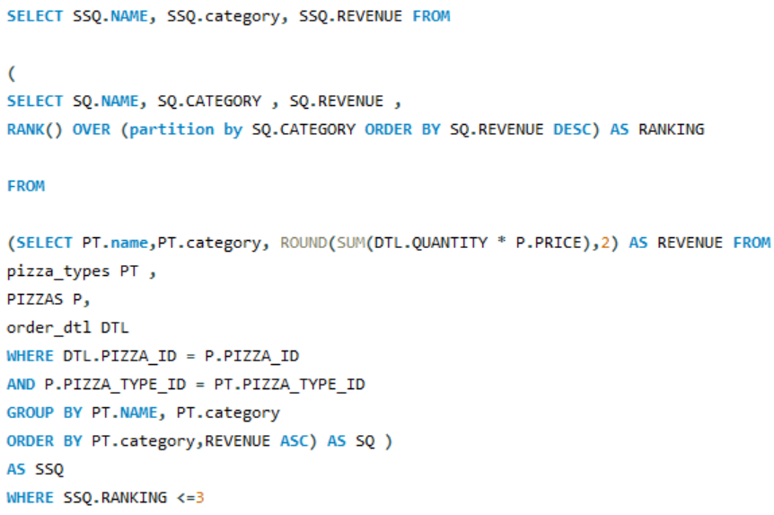
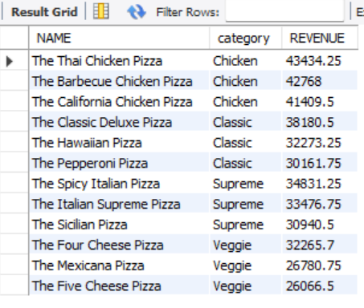
13.Determine the top 3 most ordered pizza types based on revenue for each pizza category.
Slide 16 of 17

Slide 17
Thank You
By: Mayur Mehta

